Slide 1
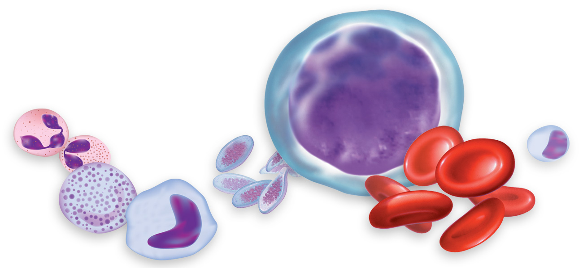
BLOOD
and
LYMPH

Slide 2
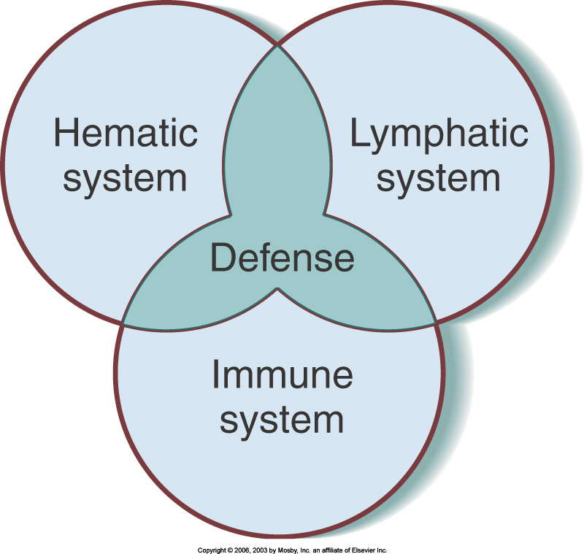

Slide 3
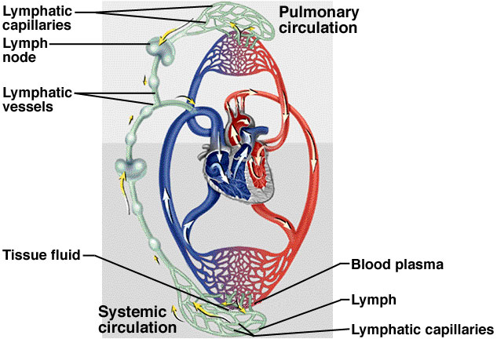

Slide 4
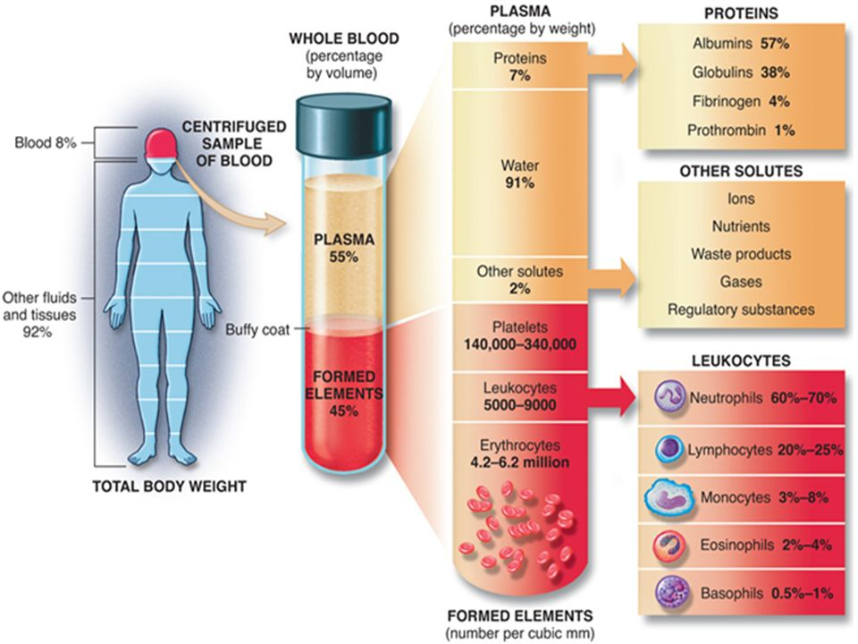

Slide 5
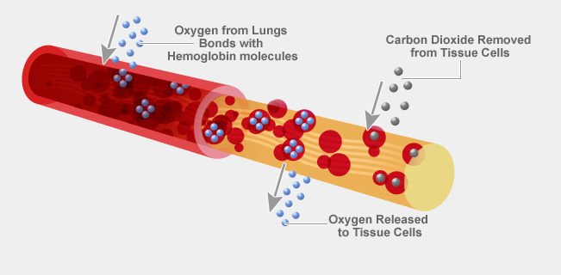
Function of blood
Transportation: The blood carries other substances around the body inside Arteries, Veins and Capillaries. These include gasses (Oxygen and Carbon Dioxide), waste products (water, urea), hormones, enzymes and nutrients (glucose, amino acids, vitamins and minerals). The blood flows through the Circulatory System.
Maintaining Homeostasis: Altering the blood flow to the skin can help to reduce body temperature. Transportation of enzymes which are used to maintain our internal environments.
Immunity and defense: White blood cells fight infection and platelets help repair damage and clot the blood

Slide 6
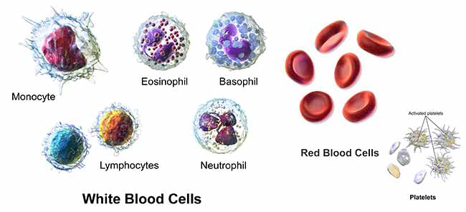
Composition of blood: Blood is made up of a number of types of cells:
Plasma: Plasma is a straw-coloured fluid in which blood cells are suspended. It is made up of approximately 90% water as well as electrolytes such as sodium and potassium and proteins.
Red Blood Cells (Erythrocytes): The main function of red blood cells is to carry oxygen. Red blood cells contain a protein called Haemoglobin. This combines with oxygen to form Oxyhaemoglobin. Each red blood cell has a lifespan of approximately 120 days before it gets broken down by the spleen. New cells are manufactured in the bone marrow of most bones. There are approximately 4.5-5 million red cells per micro-litre of blood.
White Blood Cells (Leucocytes): There a number of types of white blood cells, although the function of all of them is to help fight disease and infection. They typically have a lifespan of a few days and there are only 5-10 thousand WBC's per micro-litre of blood.
Platelets (Thrombocytes): Platelets are disc shaped cell fragments which are involved in clotting the blood to prevent the excess loss of body fluids

Slide 7
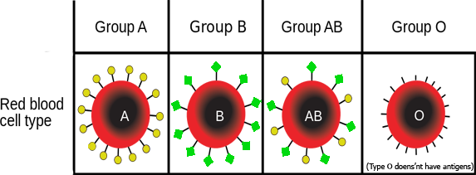
Blood types
Although all blood is made of the same basic parts, not all blood is the same. There are eight different common variants know as blood types, which differ by the presence of or lack of antigens. Antigens are substances, which can trigger the immune system to fight infection or diseases. If someone is given the wrong type of blood in a blood transfusion then it is possible the antigens will trigger an immune response to the transfused blood causing it to be rejected by the body.

Slide 8
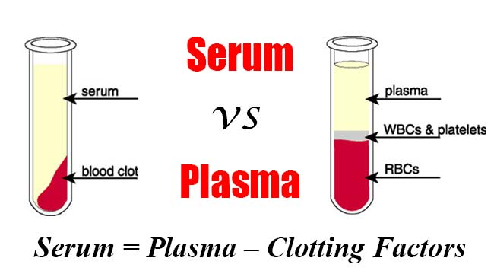

Slide 9
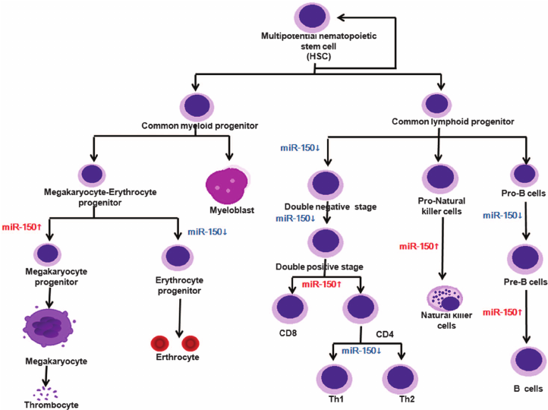
Hematopoesis is the formation of blood cellular components. All cellular blood components are derived from haematopoietic stem cells. In a healthy adult person, approximately 10¹¹–10¹² new blood cells are produced daily in order to maintain steady state levels in the peripheral circulation.

Slide 10
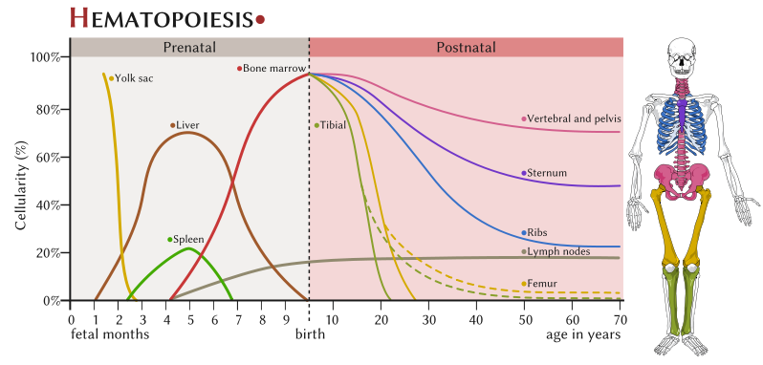
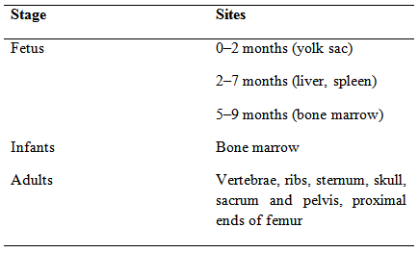

Slide 11
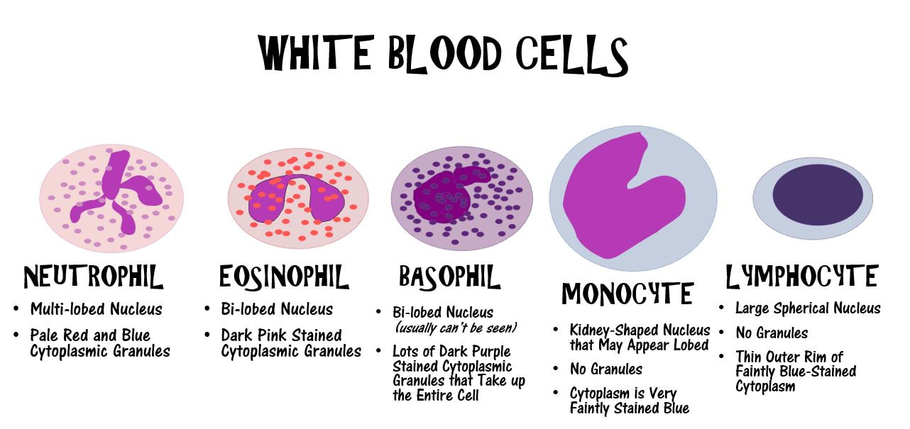

Slide 12
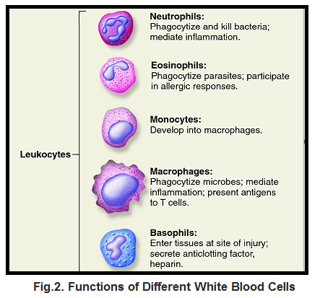

Slide 13
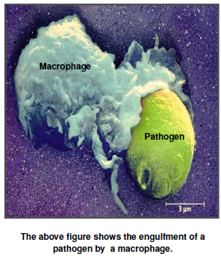

Slide 14
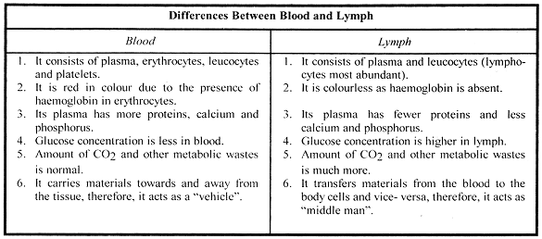

Slide 15
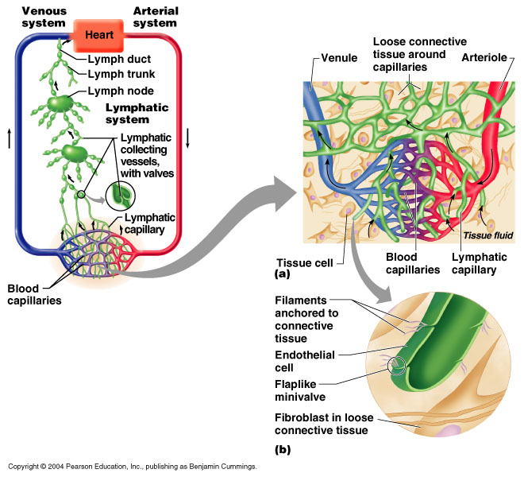

Slide 16
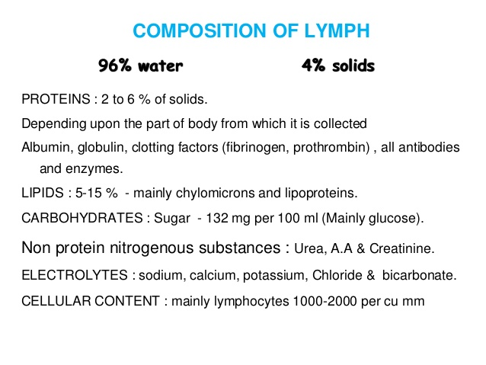
The lymphatic system plays a major role in the body's immune system, as the primary site for cells relating to adaptive immune system including T-cells and B-cells. Cells in the lymphatic system react to antigens presented or found by the cells directly or by other dendritic cells. When an antigen is recognized, an immunological cascade begins involving the activation and recruitment of more and more cells, the production of antibodies and cytokines and the recruitment of other immunological cells such as macrophages.

Slide 17
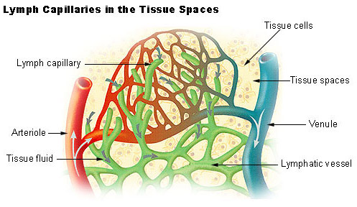

Slide 18
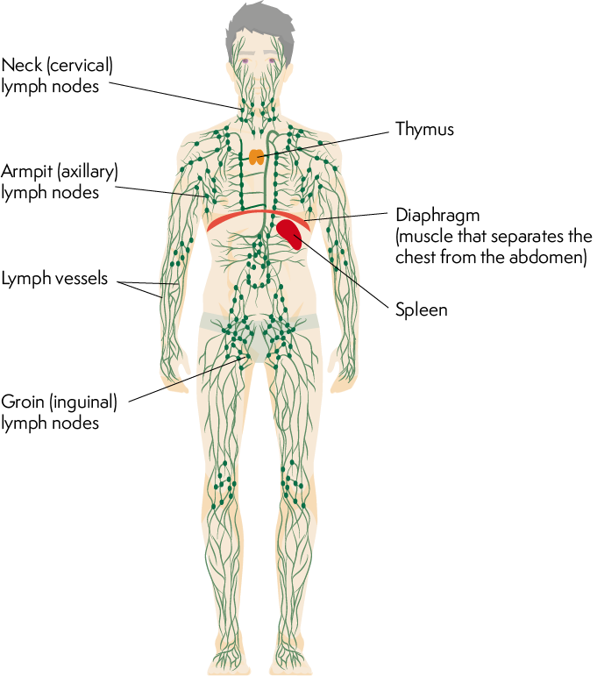
Organs of lymphatic system

Slide 19
Functions of lymphatic system
The functions of the lymphatic system.
(1) to return excess interstitial fluid (lymph) and its dissolved solutes (electrolytes, nutrients, wastes, regulatory substances, immune system molecules) to the systemic circulation. (2) to transport dietary fats/lipids (in the form of chylomicrons) absorbed from the meal at the intestines to the adipocytes via the systemic circulation. (3) to contribute to specific immune defenses by:
(a) serving as a route for leukocyte movements,
(b) filtering lymph at the lymph nodes,
(c) filtering blood at the spleen,
(d) providing the location and opportunity for specific leukocytes, especially lymphocytes, to encounter and respond to foreign and tumor antigens.

Slide 20
Mechanics of the lymphatic flow
The three means/mechanisms by which lymph flow (returning lymph fluid to the circulatory system) is facilitated.
(1) valves in lymphatic vessels which prevent backflow within the lymphatic drainage system.
(2) skeletal muscle pump - the contraction of skeletal muscles in the limbs assists with lymph return from the limbs because lymph vessels are guarded by valves to prevent back flow of lymph; as a result, skeletal muscle contraction provides an extravascular compression on these lymph vessels which moves the lymph forward (and against gravity) back toward the systemic circulation.
(3) respiratory pump - the contraction of the diaphragm and intercostal muscles in the thoracic cavity assists with lymph return to the systemic circulation because each time a person inhales, there is a slight but significant drop in internal thoracic pressure which creates a pressure gradient which assists in the flow of lymph moving forward (and against gravity) back toward the systemic circulation.

Slide 21
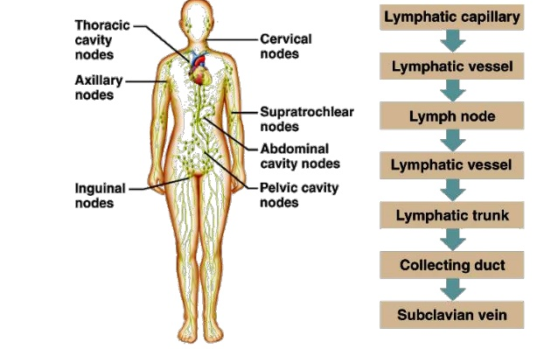
Organs of the lymphatic system

Slide 22
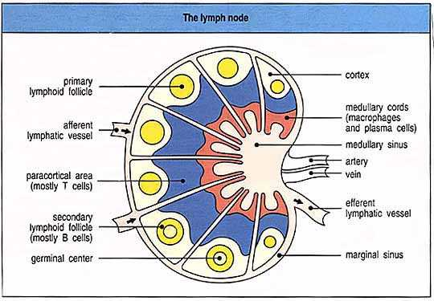
Lymph node

Slide 23
Organs of the lymphatic system
lymph - The specific name give to the clear, yellowish protein-poor fluid located between cells in all connective tissues except blood and cartilage after it has been collected into the vessels of the lymphatic drainage system.
lymph flow is regulated by Interstitial Fluid Hydrostatic Pressure, the muscular pump in the limbs, the thoracic pump in the chest, and valves which prevent backflow.
lymph capillary - The smallest lymph vessels which are open at the distal end to admit lymph (interstitial fluid = intercellular fluid = tissue fluid) from the tissue spaces; the walls consist of a simple squamous endothelium with a poorly developed basement membrane; lymph flow is regulated by gravity, Interstitial Fluid Hydrostatic Pressure, the muscular pump in the limbs, and the thoracic pump in the chest.

Slide 24
Organs of the lymphatic system
lymph vessel - Any of the delicate thin-walled vascular tubes, lined with endothelium and a very thin outer areolar connective tissue wrapping, which transport lymph (interstitial fluid = intercellular fluid = tissue fluid) from the tissue spaces back to the systemic circulation.
anchoring filaments - Collagen fiber which attach the endothelial cells of lymph capillaries to the surrounding tissue structures so that any increase in interstitial fluid volume opens the minivalves (loose connections between endothelial cells), rather than causing the lymph capillaries to collapse.
lacteal - Any of the numerous minute lymph capillaries, located in the intestinal villi, which convey chyle (lymph containing lipids absorbed from the meal and packaged in chylomicrons) from the intestine to the lymphatic circulation and thereby to the thoracic duct and then to the systemic blood circulation; lymph flow is regulated by Interstitial Fluid Hydrostatic Pressure.

Slide 25
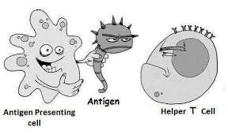
Antigen Presentation

Slide 26
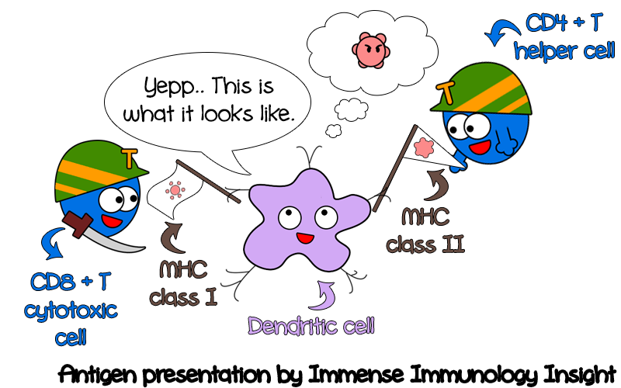
Antigen Presentation

Slide 27
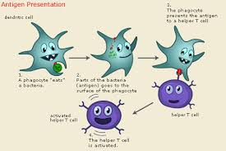

Slide 28
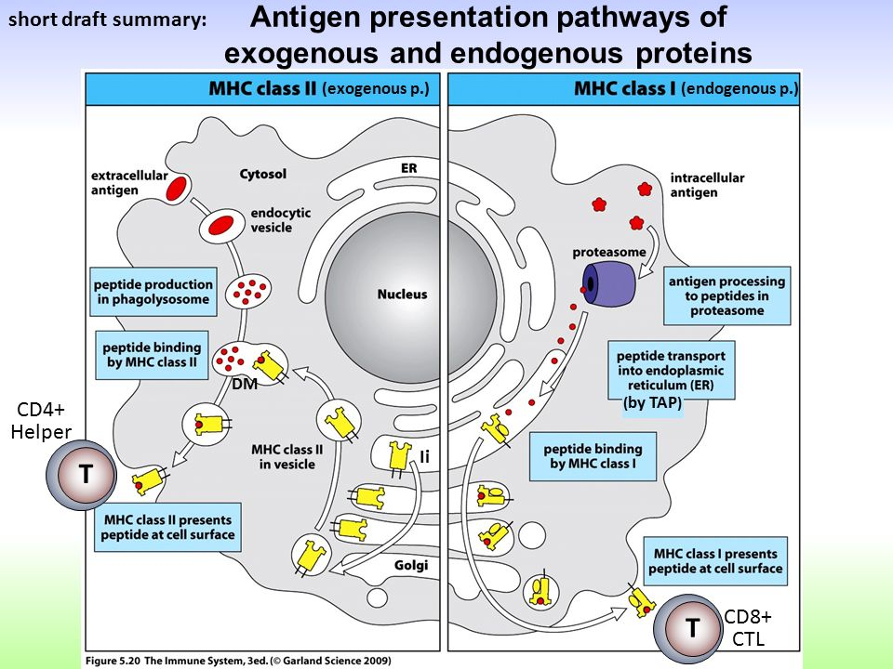

Slide 29
